Slide 1

Annual Installation Banquet
Wednesday, June 15, 2016
Special Guest: District Governor Larry Webb
Richardson Woman’s Club

Slide 2

100% Perfect Attendance 2015-2016
64% of Membership (29 Members)
Woody Alexander David Loughridge
Joe Allinder Bruce MacPherson
David Blanchard George McKearin
Tom Brooks Wendall Ritz
Doug Crosby Gwen Savant
Mark Denny D. Schieferstein
Scott Dunn Ken Schwartz
Karen Ellis Kenn Smith
Ted Ellis Langford Sneed
Darryl Fourte Bill Walker
Jim Henderson Faye Willis
Kathy Higgins Theresa Yarbrough
Byron Johnson Bill Zeigler
Keith Kockler Scott Zimmerman
Bill Latham

Slide 3
Annual Installation Banquet
Wednesday, June 15, 2016
Special Guest: District Governor Larry Webb
Richardson Woman’s Club

Slide 4
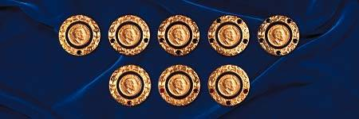
Paul Harris Recognitions
2015-16
Previously Awarded
David Allen
+1 Sapphire
Kathy Higgins
+3 Sapphires
Byron Johnson
+4 Sapphires
Awarding Tonight
Monica Scott
+1 Sapphire
Bruce MacPherson
+1 Sapphire
Woody Alexander
+3 Sapphires
Past Due/Over Due
Wendall Ritz
+3 Sapphires

Slide 5
Annual Installation Banquet
Wednesday, June 15, 2016
Special Guest: District Governor Larry Webb
Richardson Woman’s Club

Slide 6


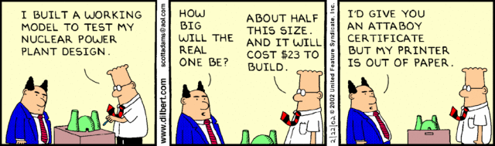
It’s time for our annual…

Slide 7
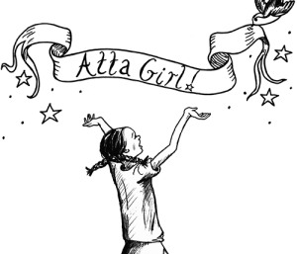





To
Gwen Savant
For
Many hours on several committees to make sure “the notes” are documented, accurate and available!
Excellent work as Secretary. A great smile welcoming all our visitors!
Being cheerful, positive. Always willing to jump in and help!
Four living up to the Four-Way-Test!
To
Karen Ellis
For
Successful leadership of Scholarship Committee!
Overall service as Chairman of Community Events!
To
Bill Latham
For
Always willing to serve above self…whenever asked!
Filling in and covering Secretary duties when Gwen was unavailable.

Slide 8
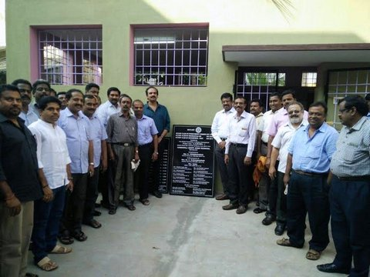

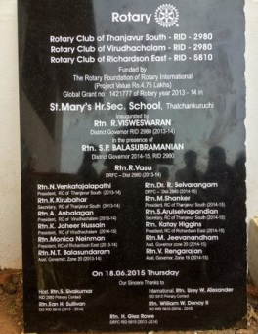

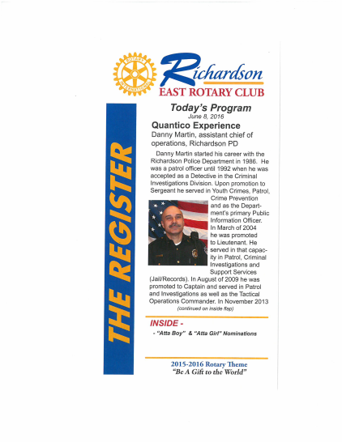
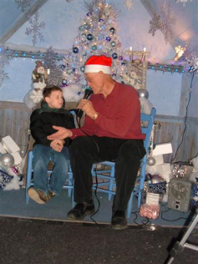

To
Woody Alexander
For
Constant leadership on the International front!
Consistent efforts in making sure the Rotary grant process did
not fall through the cracks!
Great follow through and good humor on the glamorous potty project in India…truly giving RERC an International footprint and accomplishment we all can share and take pride in!
To
Tom Brooks
For
Weekly bulletin excellence!
Dedicated service!
Always willing to do whatever needs doing!
To
David Loughridge
For
Having many, many years ago, started Santa’s Village that led to RERC’s continued Community Service of running K-Elf Studio, which enjoyed yet another outstanding year under Karen’s leadership.

Slide 9

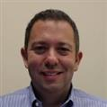


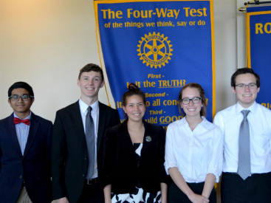

To
Scott Zimmerman
For
Extraordinary work on this year’s Casino Night!
Extraordinary work and vision already underway for our new Signature Fundraising format in 2017. Has the “Big Picture” in mind and is leading the effort.
Outstanding work heading up programs that have been interesting and timely! One of the most time-consuming and crucial jobs in our club!
Being a positive influencer and motivator!
To
Theresa Yarbrough
For
Leadership and guidance of RYLA program!
Dogged determination working to make an Interact Club a reality!
To
Scott Dunn
For
Stepping in on short notice to coordinate the student 4-Way Test program after Amanda resigned from the Club to take on a new job.

Slide 10

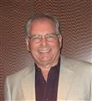




To
Bill Zeigler
For
For assisting Theresa with finding sponsors for establishing an Interact Club at J.J. Pearce High School, at a critical time when she was out-of-pocket helping her mom.
Being active in creating positive club involvement by members and always pursuing excellence as a goal.
To
“D” Schieferstein
For
Positive club involvement and ticket sales coordination for Casino Night.
To
Ron Wilson
For
Having the vision and drive to take Casino Night sponsorships to a whole new level.

Slide 11


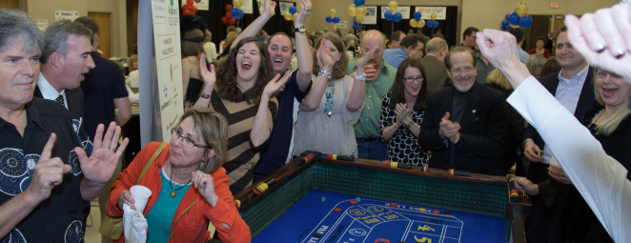




To
Wendall Ritz
For
Fundraising efforts and positive club involvement
Simply put…being “Mr. Casino Night!” year-in and year-out.
To
David Frazee
For
Organization & implementation of operations plan for Casino Night. Terrific job covering all the bases through careful planning and execution.
Hosting (with Barbara’s permission and guidance) a most enjoyable “Fiesta Night” club social in their home.
To
Ted Ellis & Ken Schwartz
For
Their many hours spent keeping the Club and the Foundation solvent and legal…$$$$

Slide 12

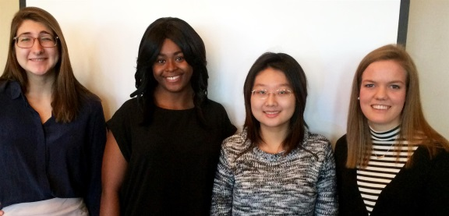
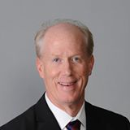
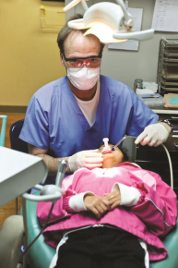
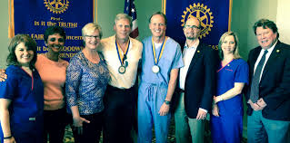



To
Faye Willis, Ken Schwartz & Rick Kimball
For
Outstanding dedication to scholarship process, having spent hours on reviewing applications, conducting interviews, and going forward as mentors.
To
Doug Crosby & Mark Denny
For
Their continued support and service of our NETWORK Dental Clinic
Plus: Mark and Kathleen hosting our annual Christmas Party
Plus: Doug for stepping in to be official photographer tonight!!!!
To
Tom Brooks, Ken Schwartz, & Ted Ellis
For
Giving back to Rotary much more than is expected with their time and their passion to serve…
Their special talents allowing RERC to excel in so many ways…
Changing lives with their commitment and love for “Service Above Self.”

Slide 13

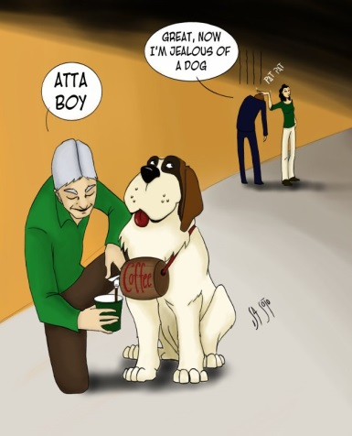



Without question everyone in our club truly deserves an Attaboy or Attagirl
My thanks to all of you for having been and continuing to… “Be A Gift to the World”

Slide 14
Annual Installation Banquet
Wednesday, June 15, 2016
Special Guest: District Governor Larry Webb
Richardson Woman’s Club

